Slide 1
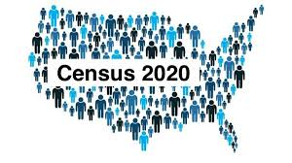
2020 CENSUS DATA REPORT
In Relation to 4CD Trustee Wards
Presented to the Governing Board on November 10, 2021

Slide 2
BACKGROUND
4CD AND VOTING AREAS
On November 9, 2011, the Governing Board approved Board Report No. 31-A - Proposed Changes to Achieve Ward Equalization.
Contra Costa Community College District | 2020 Census and Redistricting

Slide 3
CENSUS DATA AND REDISTRICTING
EDUCATION CODE SECTION 5019.5
College districts that elect members of their governing boards in by-area elections, such as 4CD, are required after every Census to:
review the population data to determine if their voting areas are still within the allowable variance; and
make any necessary adjustments to the areas to ensure population balance within legal requirements.
Under current law, college districts are required to complete the process by February 28 of the year following Census data release.
Contra Costa Community College District | 2020 Census and Redistricting

Slide 4
2020 CENSUS DATA
4CD DEMOGRAPHICS
Validated redistricting data was released by the California Department of Finance on September 20, 2021.
This data showed substantial changes in the area served by 4CD from 2010 to 2020, including:
overall population growth of 116,902 (11.1%); and
changes in the demographic composition, most notably, increases in the proportional share of Hispanic/Latino populations.
Population | Total Population
 | 2010 Census | 2020 Census | Total Change | Percent Change
Contra Costa CCD | 1,049,025 | 1,165,927 | 116,902 | 11.1%
Contra Costa Community College District | 2020 Census and Redistricting

Slide 5
4CD DEMOGRAPHICS
2010 VERSUS 2020 CENSUS COMPARISON
Trustee Area | 2010 Census |  | 2020 Census |  |  | Overall Change
 | Total | Variance | Total | Variance |  | # | %
Trustee Area 1 | 206,296 | -1.7% | 227,556 | -2.4% |  | 21,260 | 10.3%
Trustee Area 2 | 208,512 | -0.6% | 224,616 | -3.7% |  | 16,104 | 7.7%
Trustee Area 3 | 208,306 | -0.7% | 223,052 | -4.4% |  | 14,729 | 7.1%
Trustee Area 4 | 212,780 | 1.4% | 241,052 | 3.4% |  | 28,272 | 13.3%
Trustee Area 5 | 213,131 | 1.6% | 249,668 | 7.1% |  | 36,537 | 17.1%
Total Population | 1,049,025 | 3.3% | 1,165,927 | 11.5% |  | 116,902 | 11.1%
Contra Costa Community College District | 2020 Census and Redistricting

Slide 6
4CD DEMOGRAPHICS
2020 CENSUS DATA
Population | Total Population |  | Age 18 and over
 | Total | % | Total | %
Hispanic/Latino | 314,900 | 27.0% | 220,469 | 24.4%
White | 455,421 | 39.1% | 382,285 | 42.4%
Black/African American | 97,994 | 8.4% | 76,478 | 8.5%
American Indian/ Alaska Native | 2,553 | 0.2% | 2,063 | 0.2%
Asian | 214,520 | 18.4% | 170,082 | 18.8%
Native Hawaiian/ Pacific Islander | 5,720 | 0.5% | 4,483 | 0.5%
Other | 8,366 | 0.7% | 5,987 | 0.7%
Two or More Races | 66,453 | 5.7% | 40,825 | 4.5%
Total | 1,165,927 | 100% | 902,672 | 100%
Contra Costa Community College District | 2020 Census and Redistricting

Slide 7
4CD DEMOGRAPHICS
UPDATED CITIZEN VOTING AGE POPULATION ESTIMATES
Population | 2015-2019 CVAP | Age 18 and over
 | Total | %
Hispanic/Latino | 137,310 | 18.0%
White | 400,775 | 52.7%
Black/African American | 72,808 | 9.6%
American Indian / Alaska Native | 1,873 | 0.2%
Asian | 115,660 | 15.2%
Native Hawaiian/ Pacific Islander | 3,461 | 0.5%
Two or More Races | 29,128 | 3.8%
Total | 761,015 | 100%
Contra Costa Community College District | 2020 Census and Redistricting

Slide 8
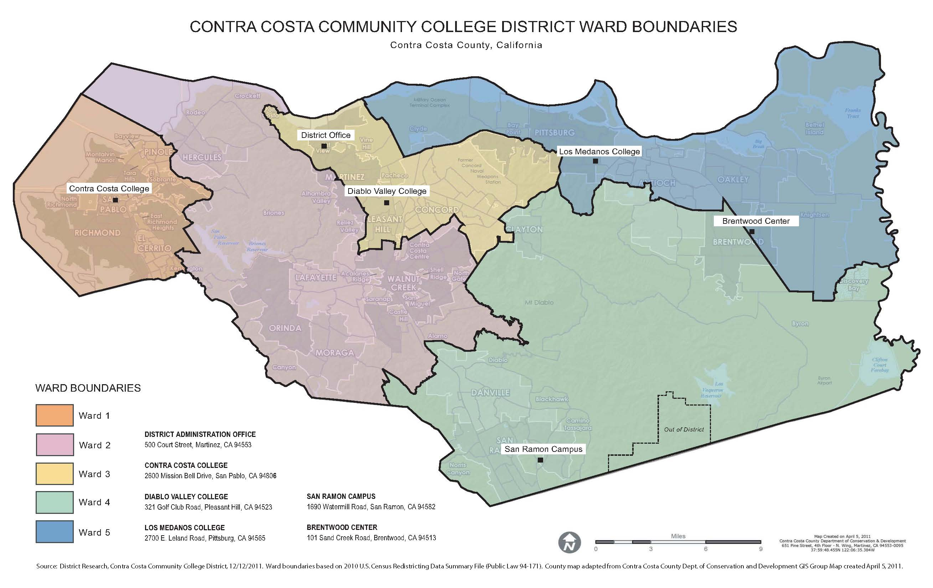
CURRENT TRUSTEE AREAS
Rebecca
Barrett
Fernando Sandoval
John
Márquez
Judy Walters
Andy Li

Slide 9
CENSUS COMPARISON
 | Total Population | Ideal Trustee Area Size | Total Variance
2010 Census | 1,049,025 | 209,805 | 3.3%
2020 Census | 1,165,927 | 233,185 | 11.5%
CURRENT TRUSTEE AREAS
TRUSTEE AREA | Trustee Area 1 |  | Trustee Area 2 |  | Trustee Area 3 |  | Trustee Area 4 |  | Trustee Area 5
Census | 2010 | 2020 | 2010 | 2020 | 2010 | 2020 | 2010 | 2020 | 2010 | 2020
Population | 206,296 | 227,556 | 208,512 | 224,616 | 208,306 | 223,035 | 212,780 | 241,052 | 213,131 | 249,668
Population Variance | -1.7% | -2.4% | -0.6% | -3.7% | -0.7% | -4.4% | 1.4% | 3.4% | 1.6% | 7.1%
Hispanic/Latino | 36.1% | 40.8% | 9.6% | 11.9% | 25.6% | 26.6% | 12.4% | 13.8% | 38.2% | 41.2%
White | 24.3% | 21.3% | 66.1% | 57.4% | 53.9% | 45.9% | 59.0% | 45.5% | 35.2% | 26.4%
Black/African American | 19.2% | 14.2% | 4.2% | 4.0% | 3.7% | 4.2% | 4.6% | 4.8% | 13.0% | 14.3%
American Indian/ Alaska Native | 0.3% | 0.2% | 0.2% | 0.1% | 0.3% | 0.2% | 0.2% | 0.2% | 0.4% | 0.3%
Asian | 15.8% | 17.1% | 15.8% | 19.2% | 11.7% | 15.7% | 19.3% | 29.0% | 8.4% | 11.0%
Native Hawaiian/ Other Pacific Islander | 0.4% | 0.5% | 0.2% | 0.2% | 0.5% | 0.5% | 0.2% | 0.3% | 0.6% | 0.9%
Other | 0.5% | 1.0% | 0.3% | 0.7% | 0.2% | 0.7% | 0.2% | 0.6% | 0.2% | 0.7%
Two or More Races | 3.4% | 4.8% | 3.7% | 6.4% | 4.0% | 6.2% | 4.0% | 5.8% | 3.8% | 5.2%
*Total Population; Source: 2010 Census, PL 94-171; 2020 Census, Redistricting Database for California, Published by Statewide Database on September 27, 2021
Contra Costa Community College District | 2020 Census and Redistricting

Slide 10
CVAP COMPARISON
CURRENT TRUSTEE AREAS
TRUSTEE AREA | Trustee Area 1 |  | Trustee Area 2 |  | Trustee Area 3 |  | Trustee Area 4 |  | Trustee Area 5
CVAP | 2006-2010 | 2015-2019 | 2006-2010 | 2015-2019 | 2006-2010 | 2015-2019 | 2006-2010 | 2015-2019 | 2006-2010 | 2015-2019
Total | 167,650 | 134,820 | 121,035 | 103,295 | 163,200 | 140,775 | 201,975 | 167,980 | 251,480 | 214,145
Hispanic/Latino | 25.9% | 25.3% | 9.2% | 9.3% | 19.3% | 18.2% | 11.2% | 11.5% | 24.8% | 22.7%
White | 30.5% | 31.7% | 66.6% | 62.8% | 63.1% | 60.6% | 63.6% | 60.6% | 51.7% | 49.6%
Black/African American | 23.5% | 19.8% | 5.4% | 5.3% | 3.9% | 4.2% | 4.4% | 5.5% | 11.1% | 12.0%
American Indian/ Alaska Native | 0.3% | 0.4% | 0.2% | 0.1% | 0.3% | 0.2% | 0.3% | 0.1% | 0.4% | 0.4%
Asian | 15.9% | 18.3% | 15.0% | 18.9% | 9.2% | 12.4% | 16.4% | 18.3% | 8.3% | 10.8%
Native Hawaiian/ Other Pacific Islander | 0.3% | 0.4% | 0.3% | 0.5% | 0.6% | 0.3% | 0.2% | 0.4% | 0.8% | 0.6%
Two or More Races | 3.7% | 4.1% | 3.3% | 3.2% | 3.5% | 4.2% | 3.9% | 3.5% | 2.9% | 4.0%
*Citizen Voting Age Population (CVAP); Source: American Community Survey, 2006-2010 Dataset and 2015-2019 Dataset
Contra Costa Community College District | 2020 Census and Redistricting

Slide 11
CONSIDERATIONS IN VOTING AREAS
Each area shall contain nearly equal number of inhabitants.
Drawn to comply with the Federal Voting Rights Act.
Compact and contiguous, as much as possible.
Respect communities of interest, as much as possible.
Follow man-made and natural geographic features, as much as possible.
Respect incumbency, if possible.
Contra Costa Community College District | 2020 Census and Redistricting

Slide 12
Contra Costa Community College District | 2020 Census and Redistricting

